Slide 1
D9.4 Pilot of Cyber training & exercise Framework Roadmap
Kaunas University of Technology

Slide 2
D9.4 Pilot of Cyber training & exercise Framework Preliminary structure of the deliverable/report
Structure of Cyber training & exercise Framework (KTU)
  Knowledge areas
  The target groups
  Knowledge areas - Training & exercise activities
Cyber security Training & exercise activities
  Cyber Range (KTU)
  ...
  Cyber Games (partner XXX)
  ...

Slide 3
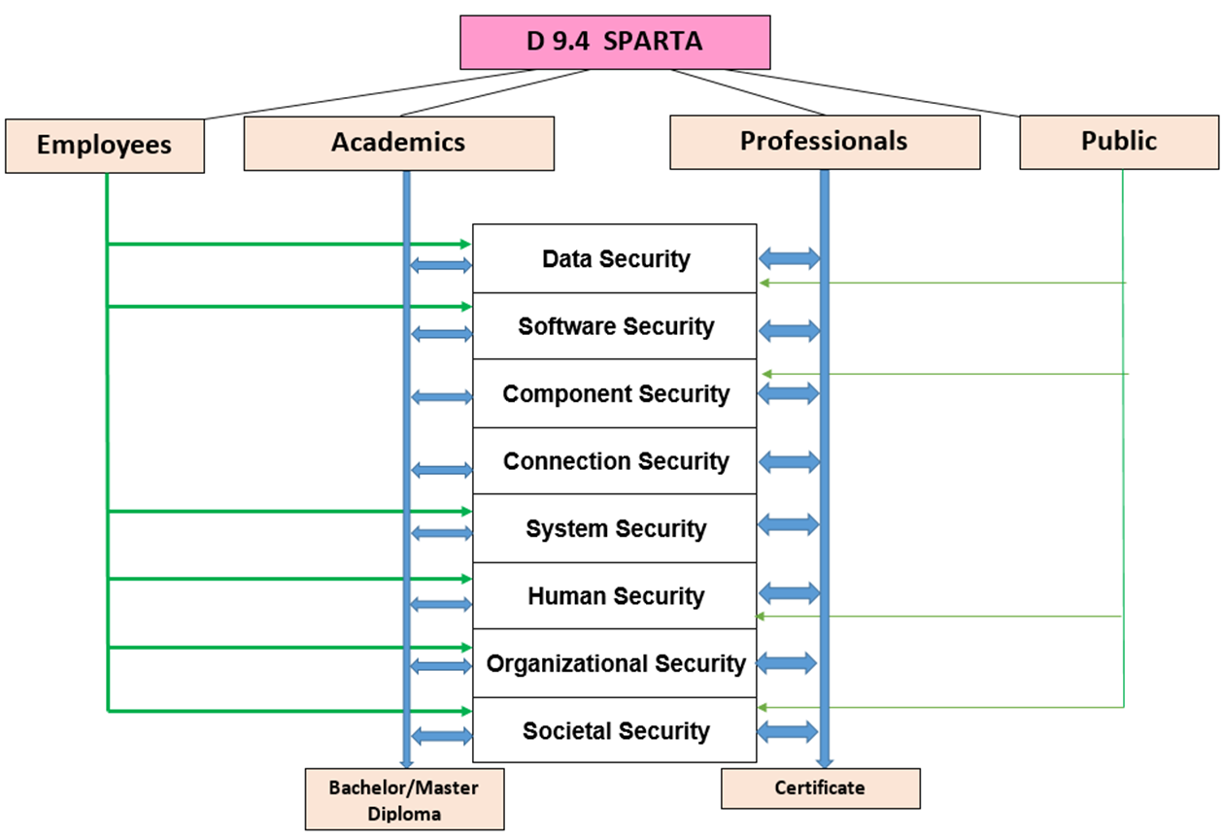
Cyber security Knowledge areas & target groups
Knowledge areas are defined by:
SPARTA-D9.1 — Cybersecurity skills
SPARTA-D9.2 — Curricula descriptions

Slide 4
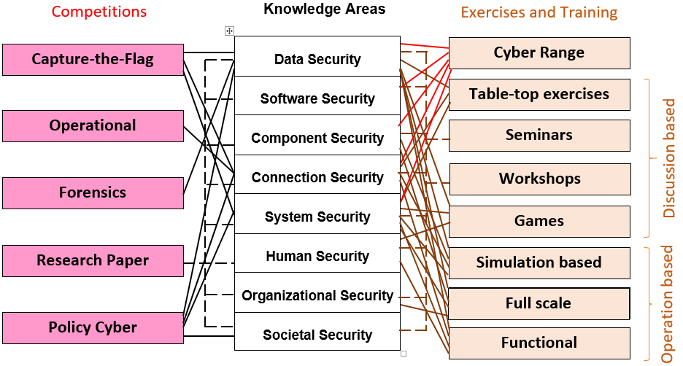
Knowledge areas - Training & exercise activities

Slide 5
Training & exercise activities
  Cyber Range (KTU)
  Table-top exercises (partner XXX)
  Seminars (partner XXX)
  Workshops (partner XXX)
  Cyber Games (partner XXX)
  Simulation based (partner XXX)
  Capture-the-Flag (partner XXX, KTU example)
  ...

Slide 6
KTU Cyber Range
Cyber range - state of the art (focus on the proactive measures and technical skills)
Infrastructure of KTU cyber range
Scenarios (“story line”) of KTU cyber range
Instructions for providing of KTU cyber range

Slide 7
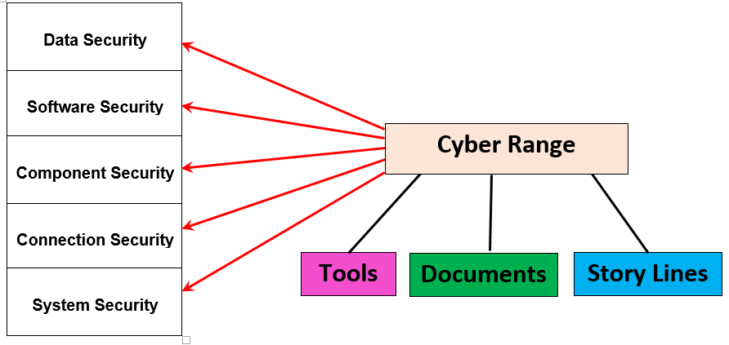
Cyber Range – COVERED KNOWLEDGE AREAS

Slide 8
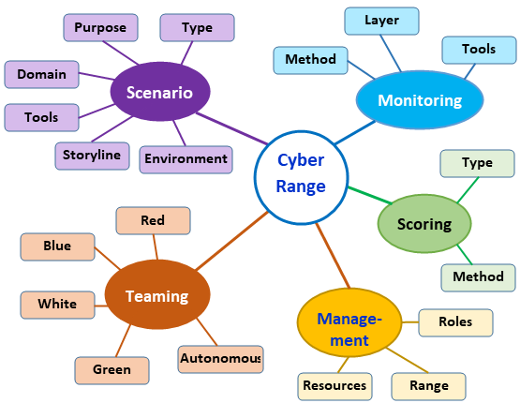
Cyber Range taxonomy (Cyber range - state of the art)

Slide 9
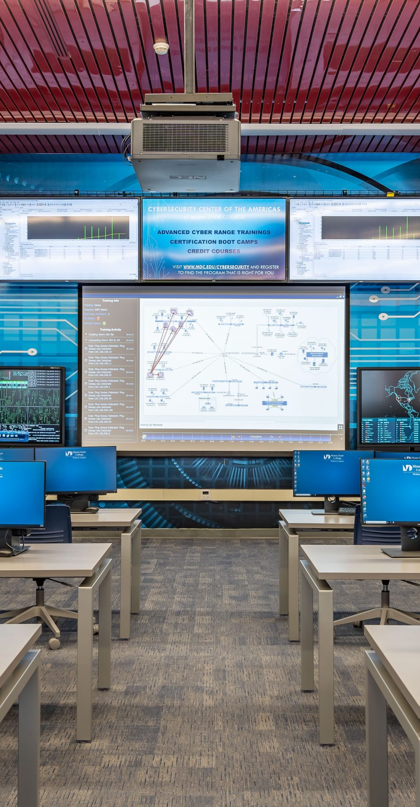
KTU cyber Range
Cyber Range
This cyber defence exercise provides a unique opportunity to all type of specialists to test the knowledge and skills they have in live-fire conditions by using technical and organizational measures.
KTU has experience in organizing National Cyber Range exercises.
Opportunity to participate not only with technical knowledge.

Slide 10
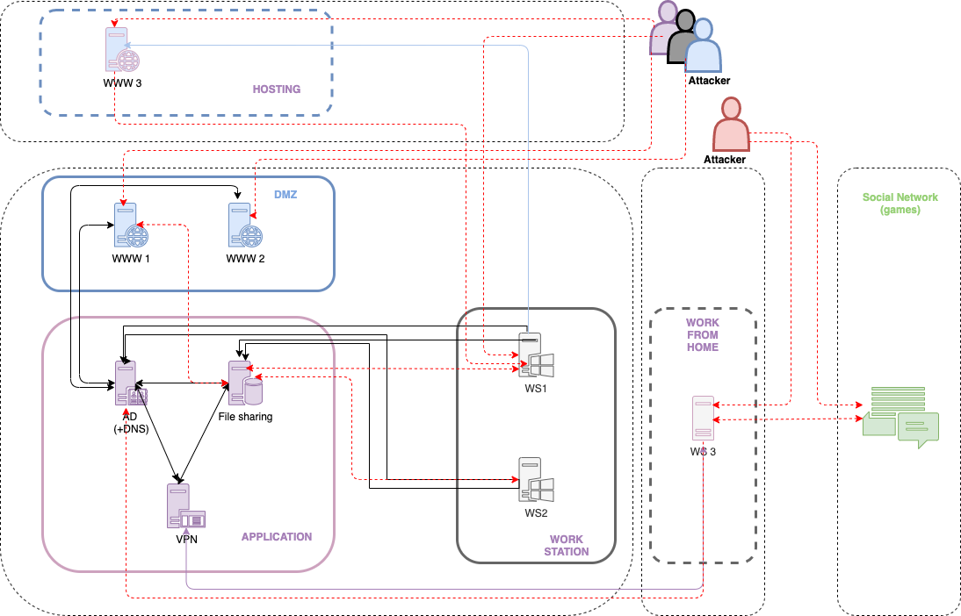
KTU Cyber Range IDEA
It is necessary to use a framework.
This may be known from the analysis already performed. It is also possible to provide your own knowledge-based framework, which will cover the organizational and technical means.
This will reach more users and get more benefits.
KTU can provide a framework which will be based on the storyline

Slide 11
Cyber Range – TOOLS, DOCUMENTS, DATA
Tools | Documents, data
password caution | access profile (username / password)
e-mail | e-mail messages
reverse-shell (Meterpreter) | LOGs
keylogger | disk images
forensic tools | WS images
SQL injection | AD image
 | network traffic flows
 | screenshots
 | various documents (.xlsx, .docx, .txt)

Slide 12
Game Based Cyber Security Training (partner XXX)
Cyber security games - state of the art
Architecture and description of XXX cyber security games
Scenarios ………….
Instructions for providing …………

Slide 13
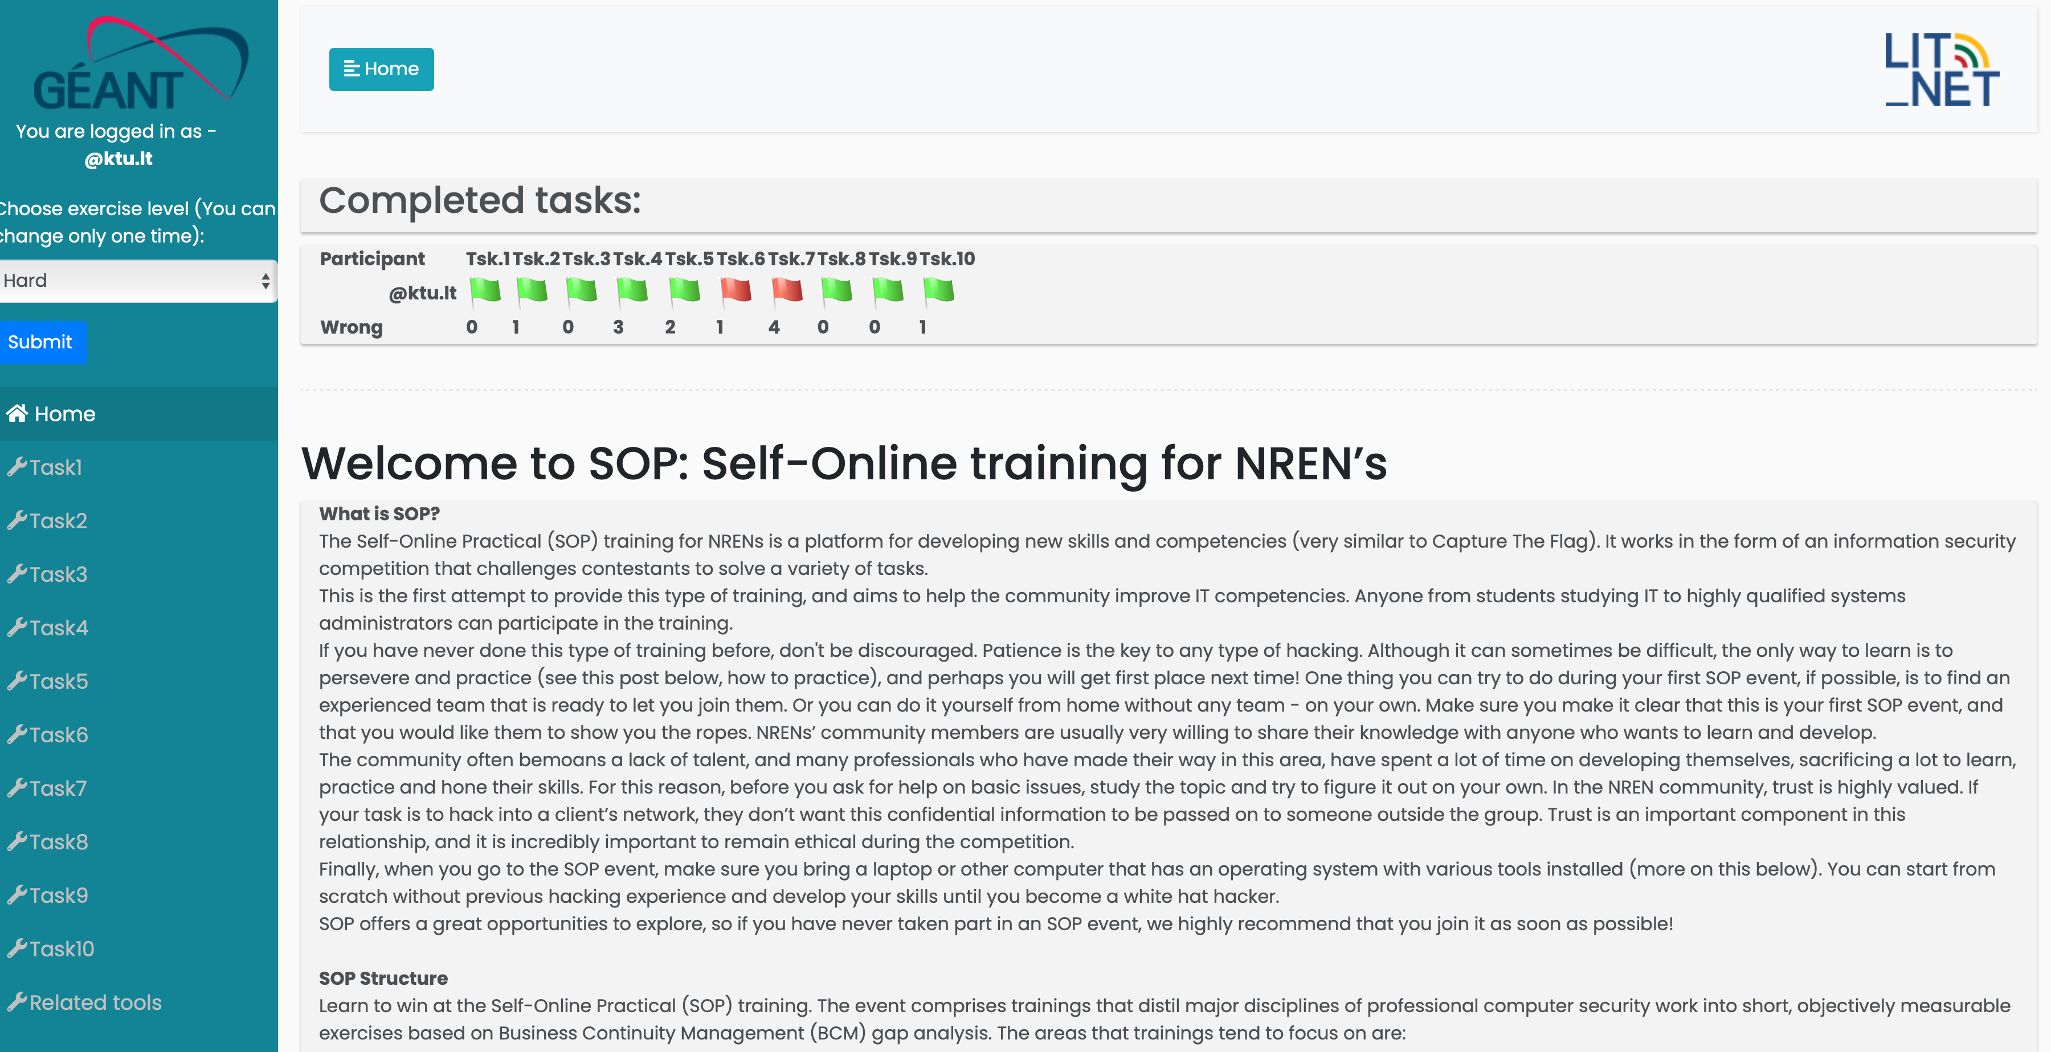
Capture the flag or self online training

Slide 14
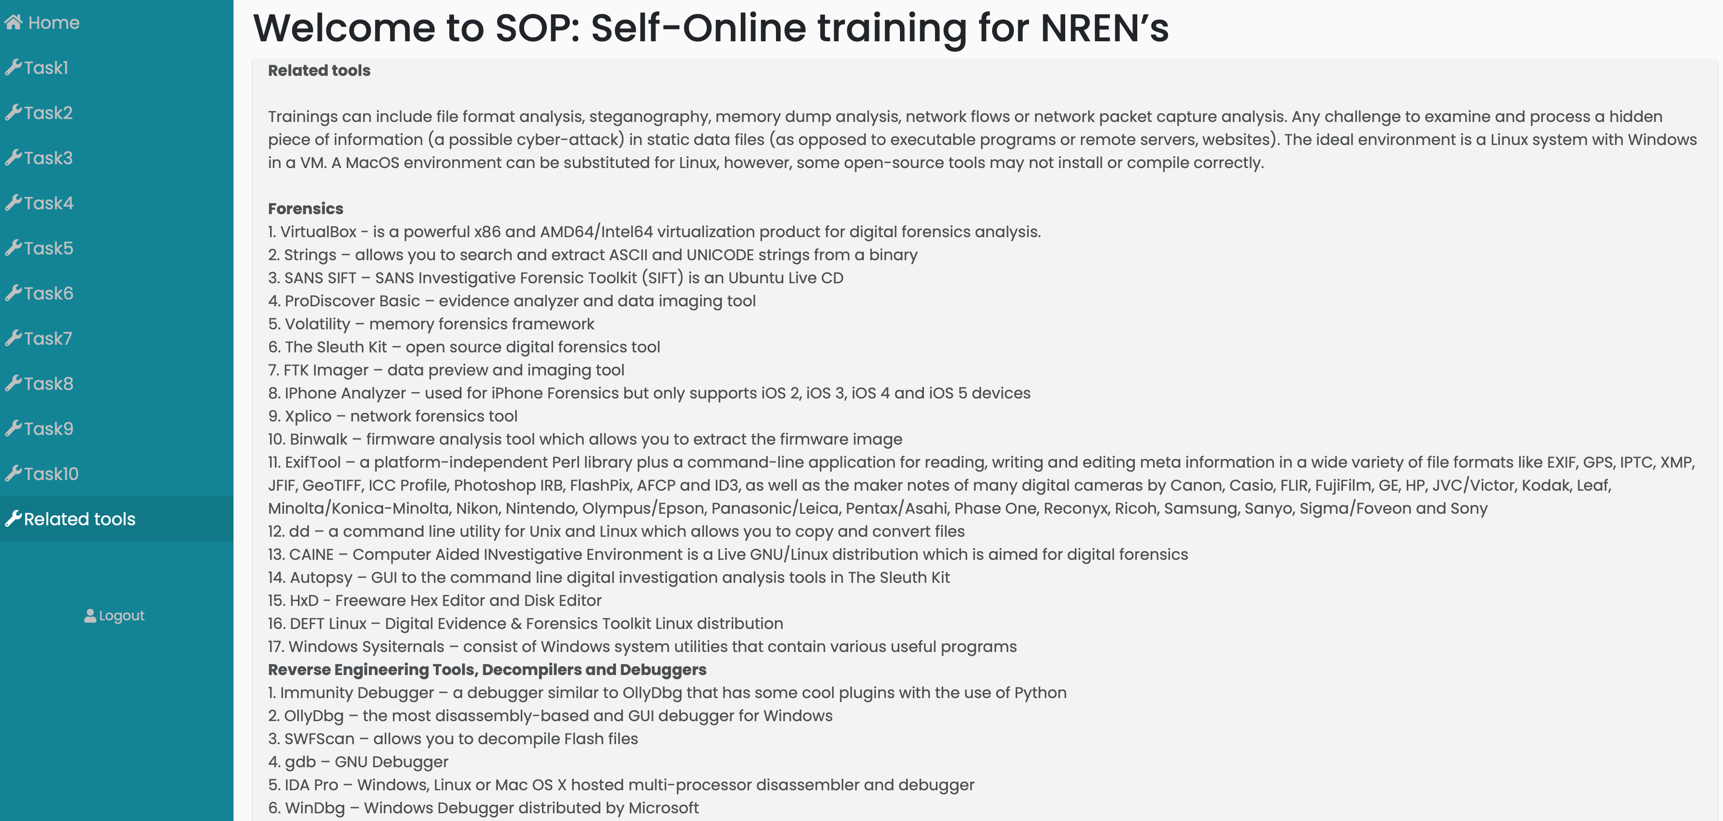
self online training tools

Slide 15
What should we (partners) do?
If the partners agree with the proposed roadmap of D9.4:
KTU will prepare Chapter I (Structure of Cyber training & exercise Framework) and develop Cyber Range (Chapter II.1).
Other partners will develop other Training & exercise activities.
...

Slide 16
D9.4 Pilot of Cyber training & exercise Framework Roadmap
Kaunas University of Technology

