Slide 1
WP 9: Cybersecurity training and awareness
SPARTA AllWP9 Meeting
Jan Hajny
@sparta_eu
sparta.eu
February 2021

Slide 2

1 – INTRODUCTION
WP9: Cybersecurity training and awareness
  Collects activities on academic programs, professional training and awareness
  Faces current problems:
    No clear identification of skills necessary for professionals in cybersecurity.
    Lack of study programs that keep pace with the technological development in cybersecurity:
      No comprehensive methodology for program design.
      Lack of good-practice curricula.
    Lack of public awareness regarding procedures and tools for the protection of ICT systems.
    Scattered environment for practical trainings: labs, cyber ranges, tools.
    …

Slide 3
2 – Scope & Objectives
OBjectives
Structure:
  Overview
  Duration: M01-M36
  WP Lead: Jan Hajny (BUT)
  Partners involved: BUT, SAP, TUM, UBO, ANSSI, IMT, YWH, CINI, CNIT, ISCOM, KTU, L3CE, SMILE, PPBW
Objectives:
  Deliver novel, non-existing skills catalogue linked to roles in cybersecurity -> SPARTA Cybersecurity Skills Framework (SPARTA CSF).
  Use the SPARTA CSF to design novel university and professional best practice curricula and guidelines how to create them.
  Evaluate the curricula with real students and in real programs.
  Extend the current infrastructure for teaching and develop novel best-practice scenarios of cyber ranges and interconnected labs.
  Governance: involve key partners and create the network for contribution to the design and exploitation of results, contribute to the synchronization and cooperation in the field of cyber security education across EU.

Slide 4
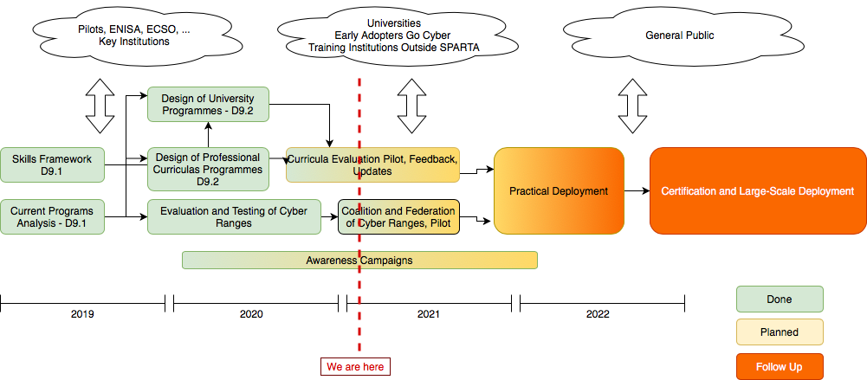
2 – SCOPE & Objectives
Roadmap

Slide 5
3 – Current Status & Achievements
Available Results
D9.1, M12, Cybersecurity Skills Framework
D9.1 – Cybersecurity Skills Framework
Deliverable Number | SU-ICT-03-830892 / D9.1
Due Date | Januray 2020 – M12
Organization | L3CE - Lithuanian Cybercrime Center of Excellence for Training, Research and Education
Editor | Edmundas Piesarskas
Dissemination | Public: https://www.sparta.eu/assets/deliverables/SPARTA-D9.1-Cybersecurity-skills-framework-PU-M12.pdf
D9.2, M18, Curricula Descriptions
D9.2 – Curricula Descriptions
Deliverable Number | SU-ICT-03-830892 / D9.2
Due Date | July 2020 – M18
Organization | BUT – Brno University of Technology
Editor | Jan Hajny
Dissemination | Public: https://www.sparta.eu/assets/deliverables/SPARTA-D9.2-Curricula-descriptions-PU-M18.pdf

Slide 6
3 – Current Status & Achievements
Available Results
D9.3, M24, Training Evaluation Pilot
D9.3 – Training Evaluation Pilot
Deliverable Number | SU-ICT-03-830892 / D9.3
Due Date | Januray 2021 – M24
Organization | PPBW – Polish Platform for Homeland Security
Editor | Klaudia Kaczmarek
Dissemination | Public: in review

Slide 7
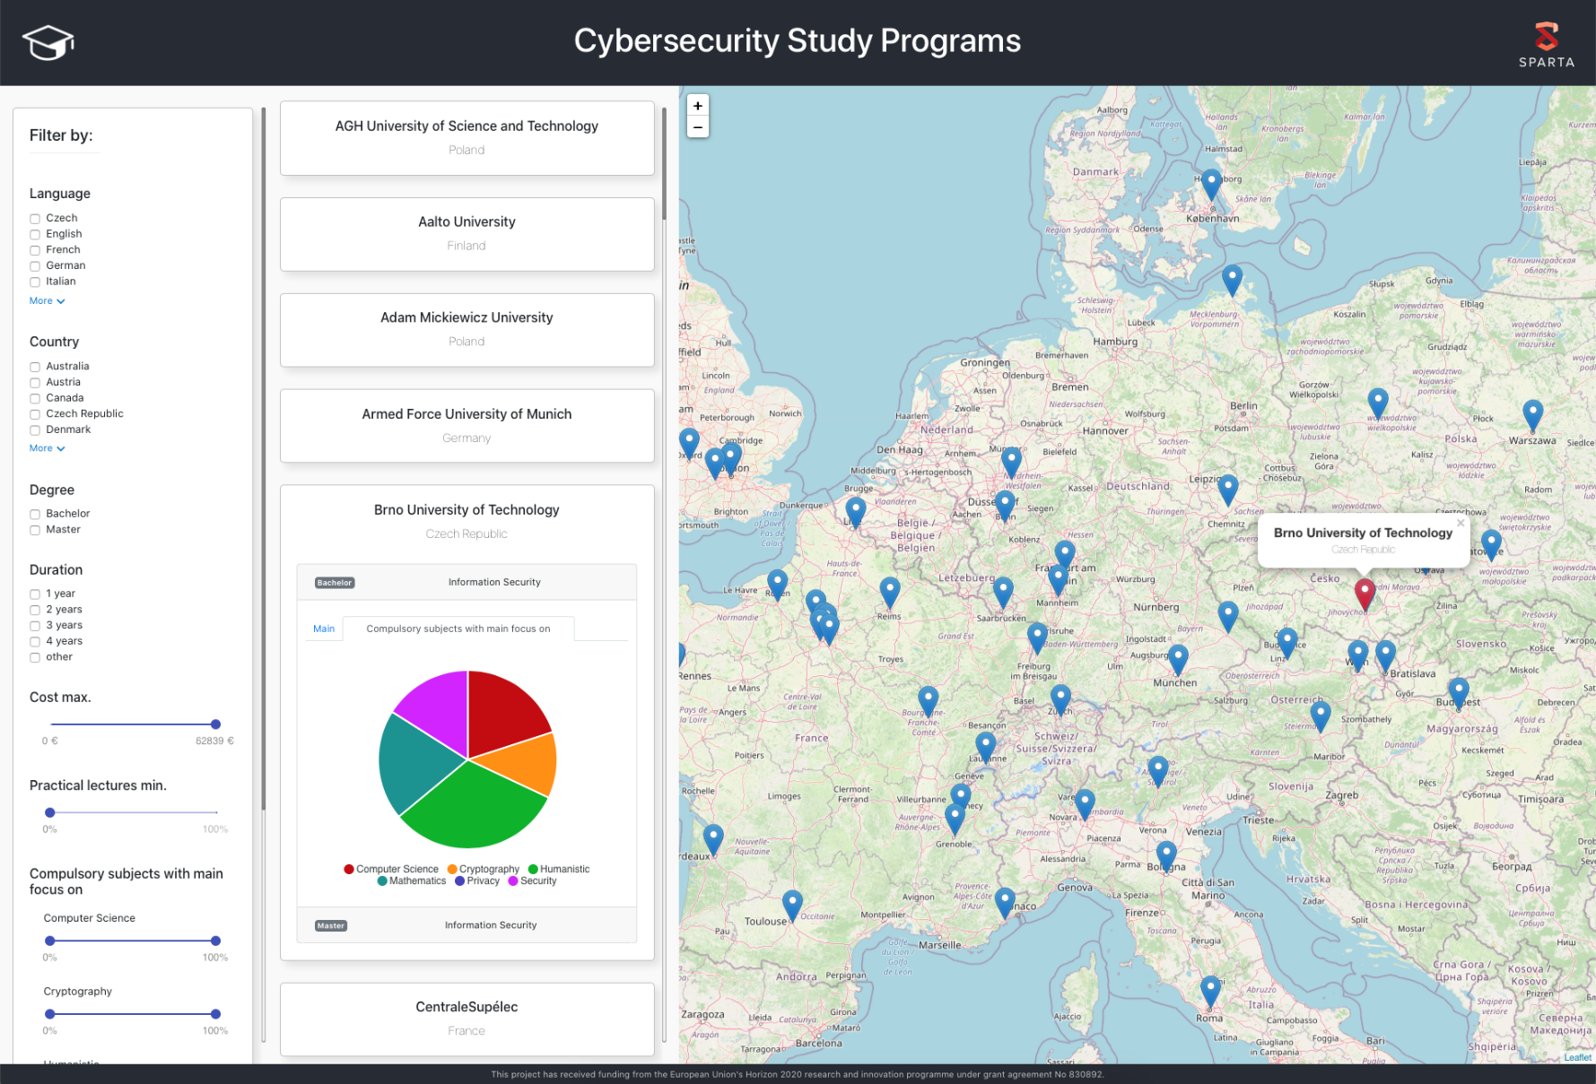
3 – Current Status & Achievements
SPARTA Education Map
SPARTA Education Map: https://www.sparta.eu/study-programs/

Slide 8
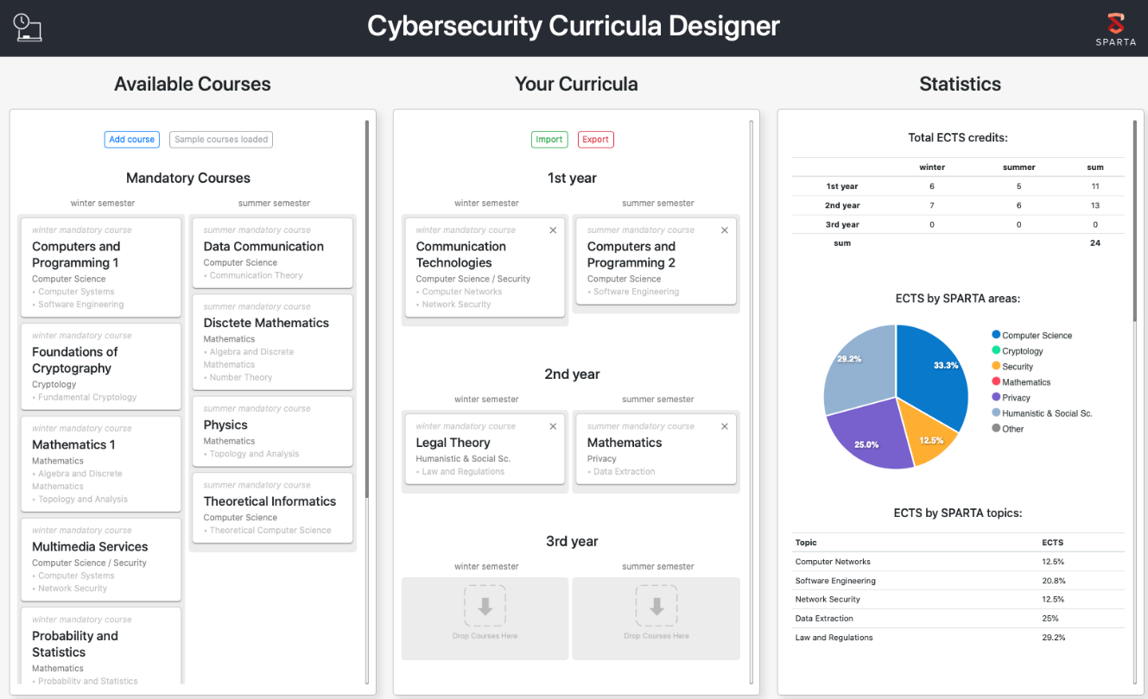
3 – Current Status & Achievements
Cybersecurity Curricula Designer
Curricula Designer Web App
A result beyond DoA that implements the SPARTA CSF and helps building customized curricula.
Based on SPARTA Topics – NICE Competencies – Work Roles mapping.
Allows identification of unsupported “standardized” work roles and consistent analysis of existing programs.
Currently in Beta, only for Bachelor’s programs.
https://curricula-designer.informacni-bezpecnost.cz

Slide 9
4 – Next Activities
Piloting and Cyber Ranges
JCCI and CyberRange Federation
OpenSource tools, available for all,
connection among labs in different countries,
ecosystem for designing and sharing of scenarios.
Pilots
Early adopters within Go Cyber with SPARTA,
universities and professional training institutions within SPARTA,
SPARTA network.
Governance and Implementation
Cooperation with ENISA, pilots, end users,
maintenance and updates of results, i.e. SPARTA Cybersecurity Skills Framework.

Slide 10
4 – Next Activities
To Deliver
D9.4, M30, Pilot of Cyber training & exercise Framework
D9.4 – Pilot of Cyber training & exercise Framework
Deliverable Number | SU-ICT-03-830892 / D9.4
Due Date | June 2021 – M30
Organization | KTU – KAUNO TECHNOLOGIJOS UNIVERSITETAS
Editor | Algimantas Venckauskas
Dissemination | Public, Demonstrator
D9.5, M36, Workplace Integration Evaluation Report
D9.5 – Workplace Integration Evaluation Report
Deliverable Number | SU-ICT-03-830892 / D9.5
Due Date | Jan 2022 – M36
Organization | IMT – INSTITUT MINES-TELECOM
Editor | Olivier Levillain
Dissemination | Public, Report

Slide 11
4 – Next Activities
To Deliver
KPIs
  #6.1 - # of courses executed using the curricula developed by the project
    Target: 20
  #6.2 - Satisfaction and # of trainees who successfully finished security-related courses designed within the project
    Target: 400
  #6.3 - # of directly addressed people (through participation at conferences, workshops, trainings, etc.) by the awareness program by the end of the project
    Target: 5000
All WP9 partners please contribute:
    https://nextcloud.sparta.eu/index.php/s/MKSMtFANfAQPkJy

Slide 12
Thank you for watching!
@sparta_eu | sparta.eu
February 2021

