Slide 1
D1.3 | Section 3.2 Transversal activities
Task 1.3 - Adaptation, synchronization, progress measurement, and improvement for governance of community and exploitation activities
(M01-M36; Task Lead: INOV)
Gonçalo Cadete (INOV)
December 1st,2020

Slide 2
D1.3 Improving a CCN pilot
3.2 Transversal activities
ToC for D1.3
  Executive summary (CEA)
  1. Introduction (Fraunhofer, contribs CEA)
  2. Internal and external recommendations (Fraunhofer, contribs CEA)
  3. Modular governance framework
    1. CCN structure (T1.1, CEA)
    2. Transversal activities (T1.3, INOV, contribs all relevant)
      1. Partnership instrument
      2. Enablers (= all other transversal activities)
    3. Scientific & technical activities (T1.2, L3CE, contribs all relevant)
  4. Lessons learnt (CEA, contribs Fraunhofer)
  5. Conclusion and perspectives (CEA, contribs Fraunhofer)
✓

Slide 3
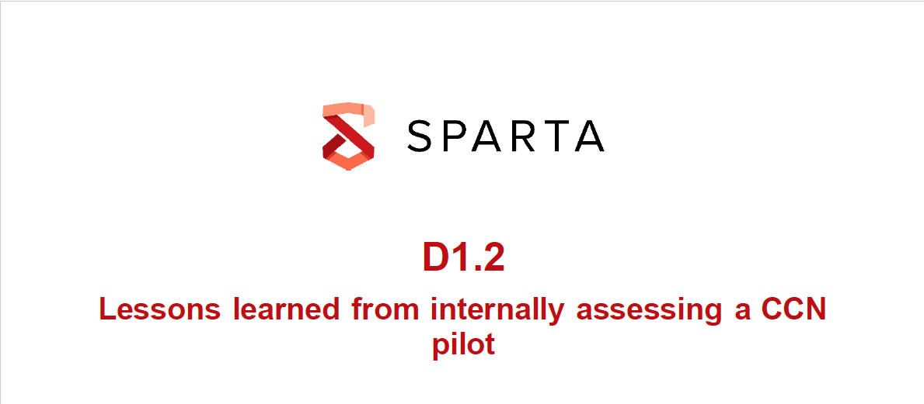
D1.3 Improving a CCN pilot
3.2 Transversal activities
Scope:
  This deliverable (i) reports how internal recommendations have been implemented and (ii) how SPARTA activities have improved in consequence.
    WP8 Clustering, platforms, and ecosystems activities (CNR, Fabio)
    WP9 Cybersecurity training and awareness (BUT, Jan)
    WP10 Sustainable exploitation and IPR (SMILE, Pascal)
    WP11 Certification organization and support (CETIC, Philippe)
    WP12 Dissemination and communication (INOV, Nelson)
Partnership instrument
Enablers
    “it will improve the activities and processes by taking into account relevant feedback coming from the assessment of the governance.”

Slide 4
D1.3 Improving a CCN pilot
3.2 Transversal activities
    “improve the activities and processes”
WP8 Clustering, platforms, and ecosystems activities (CNR, Fabio)
  Year 1 bootstrapping
    Community of Associates and Friends + Partners
    Setup the SPARTA monthly workshops
    Specify the JCCI - Joint Competence Centre Infrastructure
    Support building relationships with all the relevant projects
    Governance structures: Partnership Committee, Associates Council
  Initiatives + Recommendations (D1.2)
    GC_I1: Technical Integration: Clarify the desirable and feasible level of integration between the technical components and results produced by WP4-WP7. Clarify the achievable level of alignment between the four technical programs on the one hand and both WP8 and WP11 on the other.
  Year 2
    Report on improvements to the activities and processes
    Risks: all considered relevant
      Mitigate risks that materialized
        WP8_1 Lack of integration among the platforms
        WP8_2 Lack of integration of national ecosystems

Slide 5
D1.3 Improving a CCN pilot
3.2 Transversal activities
    “improve the activities and processes”
WP9 Cybersecurity training and awareness (BUT, Jan)
  Year 1 bootstrapping
  Initiatives + Recommendations (D1.2)
  Year 2
    Report on improvements to the activities and processes
    Risks: all considered relevant
      Mitigate risks that materialized
        Lack of cooperation from some WP9 partners

Slide 6
D1.3 Improving a CCN pilot
3.2 Transversal activities
    “improve the activities and processes”
WP10 Sustainable exploitation and IPR (SMILE, Pascal)
  Year 1 bootstrapping
  Initiatives + Recommendations (D1.2)
  Year 2
    Report on improvements to the activities and processes
    Risks: 1 risk considered not relevant, 1 risk either relevant/not relevant (check November 2020 risk evaluation)
      1 risk considered not relevant
        WP10_1 Third party licensing obligations impacting project results exploitation

Slide 7
D1.3 Improving a CCN pilot
3.2 Transversal activities
    “improve the activities and processes”
WP11 Certification organization and support (CETIC, Philippe)
  Year 1 bootstrapping
  Initiatives + Recommendations (D1.2)
    GC_I1: Technical Integration: Clarify the desirable and feasible level of integration between the technical components and results produced by WP4-WP7. Clarify the achievable level of alignment between the four technical programs on the one hand and both WP8 and WP11 on the other.
    GC_I4: Open Source: WP5 and WP6 may need support to engage with the Open Source spectrum in an active and sustainable manner. Could the scope of WP11 be extended by an activity targeting relevant Open Source communities? Are there individuals within the consortium or its group of associates who can and are would act as champions?
    GC_I6: Training: The data from the questionnaire and our technical analysis suggest a huge disconnect between WP11 and the technical programs. Is this indeed the case? Is this intentionally so? Would it be possible and desirable to establish trans-WP links?
  Year 2
    Report on improvements to the activities and processes
    Risks: all considered relevant
      WP11_1 Cybersecurity certification initiatives evolve during project duration -> ENISA EU Cybersecurity Act (CSA)

Slide 8
D1.3 Improving a CCN pilot
3.2 Transversal activities
    “improve the activities and processes”
WP12 Dissemination and communication (INOV, Nelson)
  Year 1 bootstrapping
  Initiatives + Recommendations (D1.2)
  Year 2
    Report on improvements to the activities and processes
    Risks: all considered relevant

Slide 9
Thank you for watching!

