Slide 1
WP 2 « Responsibility »
SPARTA Review
Michael Friedewald, Fraunhofer ISI
1st Year Review Meeting, Brussels
@sparta_eu
sparta.eu
February 2020

Slide 2
Summary
1 Introduction
2 Scope & Objectives
3 Current status & Achievements
4 Submitted deliverables
5 Roadmap
6 Risks & Deviations

Slide 3
1 – INTRODUCTION What we care about
Decision makers (Policy, Industry)
Solution designers (Researchers Engineers)
Different actors and interest
Affected people (citizens)
Cyberthreats are an important societal problem
Countermeasures may (and actually often do) come at the expense of other interests and values
Challenge: Inherent power imbalance
Those who decide on the importance of security (measures)
≢ those who implement them are
≢ those who are affected

Slide 4
2 – SCOPE & Objectives WP Governance
Overview
Duration: M01-M36
WP Lead: 10 Fraunhofer Institute for Systems and Innovation Research ISI
4 Core Partners: 4 University Namur, Research Centre in Information, Law and Society / 35 Mykolo Romerio University, Institute of International and European Union Law / 43 INOV INESC Inovação
11 Other Partners: all WP leads
Structure (only tasks active in Year 1)
# | Title | Lead | Date | DoA
T2.1 | Identification of CCN relevant ethical, legal and societal aspects | 4 | M1-12 | Exploration of topics that may be relevant in cybersecurity research; basis for considering more specific issues
T2.3 | Formulation of general guidelines for respon-sible cybersecurity research and innovation | 10 | M7-36 | Compilation of problems/safeguards from Tasks 2.1, 2.2 and 2.4
T2.5 | Internal ELSA auditing and supervision | 43 | M1-36 | Assessment of WP 2 activites (with an interface to task 1.4)

Slide 5
2 – SCOPE & Objectives A full WP on ethical, legal and societal aspects
Make sure that cybersecurity innovations launched by SPARTA are ethically sound, socially acceptable and compliant with applicable laws (tasks 2.1 – 2.4)
Identify isssues and raise awareness of the relevance of ELSA in the cybersecurity context among the members of the SPARTA consortium (task 2.1 – finished)
Assess implications of cybersecurity innovations launched by SPARTA (task 2.2 – ongoing)
Develop safeguards: Suggest measures to avoid serious negative implications resulting from cybersecurity innovations launched by SPARTA (task 2.4 – not started)
ELSA auditing and supervision (task 2.5 - ongoing)
have programs taken into account ELSA that have been raised? Justification for specific solutions.

Slide 6
3 – Current Status & Achievements Achievements – Ethical, legal and societal issues (1)
Wide range of socio-technical in cybersecurity research touched // SORTING OURT TERMS
Mainly from ECHR (1950) and CFREU(2000/09): Autonomy – Beneficence – Dignity – Equality – Fairness – Freedom – Justice – Non-discrimination – Privacy – Responsibility – Rule of law – Security – Solidarity …
Data Protection Goals: Availability – Confidentiality – Integrity – Intervenability – Transparency – Unlinkability
Four broader value clusters
Security (objective vs. perceived; individual vs. collective; international vs. national vs. societal vs. corporate)
Privacy (privacy of person, behaviour and action, communication, thought and feeling, location, association → many of them related to data)
Fairness (justice, equality, accessibility, non-discrimination, freedom from bias, democracy, protection of civil liberties )
Accountability (transparency, openness, explainability)
Interaction of values
Effects are ambiguous
Values may be compatible but also in conflict, e.g. Privacy vs. Security
Security measures may support privacy ► Privacy measures may support security
Security measures may endanger privacy ► Privacy measures may endanger security

Slide 7
3 – Current Status & Achievements Achievements – Ethical, legal and societal issues (2)
Cybersecurity: objectives
Safeguarding fundamental rights as laid out in “Cybersecurity Strategy of the European Union: An Open, Safe and Secure Cyberspace” (EC, 2013)
Security requirements when personal information is at stake: Protection goals – Confidentiality, Integrity, Availability, …
Core principle in the law – and in SPARTA: the risk-based approach/risk management
Adoption of technical and organisational measures (“by design” concept)
An appropriate level of security depending on the risks and the state of the art
Cybersecurity and personal data: some key questions for interaction with SPARTA programs in Year 2
What level of transparency?
How much data and what data needs to be collected?
What and how should information be given to the data subject?
What data should be accessible by whom?
How long should the data be stored?
Who will be responsible in case of data breaches?
Cybersecurity: objectives
Fundamental rights at stake
A first guidance: “by design”
Case by case analysis: key questions
Cybersecurity: Definition

Slide 8
3 – Current Status & Achievements Achievements – 1st ELSA audit
Based on audit questionnaire; interviews with all WP leaders
Opportunities for Year 2
Development of policies, procedures and guidelines
Stronger awareness for WP 2 and WP 14 deliverables – thus for privacy requirements and related implementations
Motivate, empower and engage WP leaders in promoting ELSA & RRI

Slide 9
4 – Submitted Deliverables
D2.1, M12, Identification of relevant ethical, legal and societal aspects (03-02-2020)
Reports on determining the ethical values (mainly security, privacy, fairness, accountability) and legal imperatives (fundamental rights and protection of personal data) relevant in the context of cybersecurity. Explores public attitudes towards privacy and security values.
D2.2, M12, First internal ELSA audit and supervision report (03-02-2020)
Reports on the methodology, work, and results from the ELSA audit and supervision done throughout the first year of SPARTA
D14.1, M06, DU Requirement No. 1 (31-07-2019)
Potential implications and risk-mitigation strategies related to Dual Use issues
D14.2, M01, H Requirement No. 2 (01-03-2019)
Procedures, criteria, templates, opinions, and approvals related Humans ethics issues
D14.3, M01, POPD Requirement No. 3 (01-03-2019)
Organisation and measures related to Protection of Personal Data issues

Slide 10
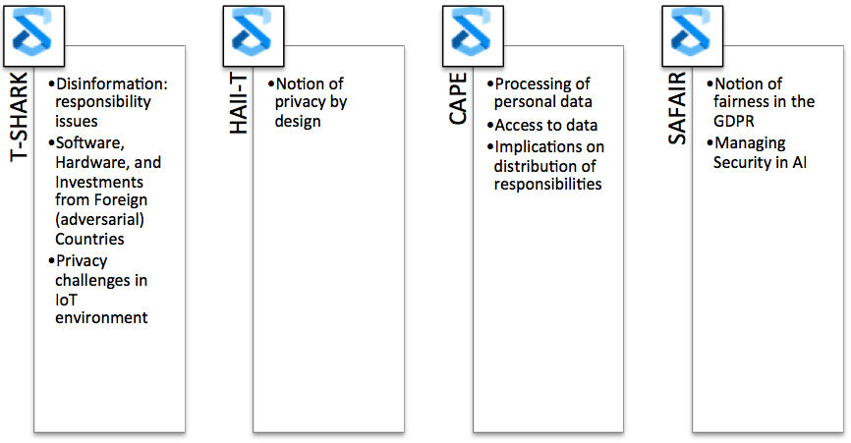
5 – Roadmap Next steps
In collaboration with WP 1: Analysis of the proposed regulation on European Cybersecurity Competence Centre
Task 2.2 Investigation of key challenges and promising solution approaches (lead – MRU)
Step 1: Mapping of challenges around demonstration cases (completed by M13)
Notes:
WP2 has to proactively gathered information / case studies – there’s no point to just wait for ‘heads-up’ from the technical work packages (never mind that the general need to participate in horizontal activities).

Slide 11
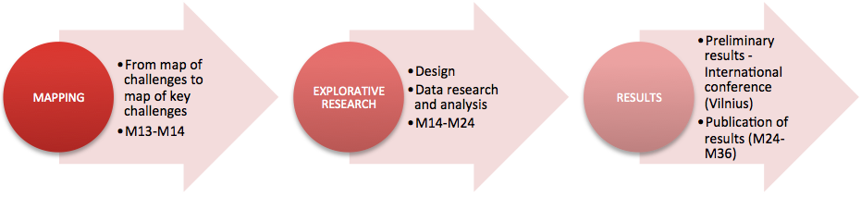
5 – Roadmap Next steps
Task 2.2 Investigation of key challenges and promising solution approaches
Step 2: Investigation
Notes:
MRU to organize workshop / corresponding publication for reaching publication KPIs
Fraunhofer to organize IFIP Summer School on Privacy and Identity Management in Security Research (together with WP 9 and Cybersec4Europe and Concordia)
Further plans for reaching out beyond WP 2: not only WP 9 on skills and training, also WP on certification

Slide 12
6 – Risks & Lessons learnt
# | Title | Severity | Occur-rence | Date | Measures planned
R2.1 | Lack of cooperation of SPARTA Programs (and activities) | critical | (N) | M12 | Closer interaction with the SPARTA programs (information push instead of information pull)
R2.2 | Lack of cooperation of external stakeholders | low | N | M12 | -
ELSA is usually difficult in R&I projects
SPARTA is doing comparably well
ELSA researcher embedded in programs works well
(More) proactive approach is planned for M14-36 to develop the level of cooperation necessary to support SPARTA programs

Slide 13
Thank you for watching!
@sparta_eu | sparta.eu
February 2020

Slide 14
Design and Processes When and How to address Ethical issues
Anticipation: What might be the intended and unintended consequences arising from R&I activities?
Reflection: What are our underlying objectives, motivations, values, assumptions and commitments that drive our research and the methods applied?
Inclusion: Are the stakeholders included, respecting their diversity, in all phases of research?
Responsiveness: How do the answers from 1- 3 inform your research and the methods applied?
An online tool to test the “Societal Readiness Level”
https://www.thinkingtool.eu
Source: NewHoRRIzon project

Slide 15
Value Conflicts in Cybersecurity
Source: CANVAS

