Slide 1
Responsibility Activity (WP 2)
Led by Fraunhofer ISI
Presented by Michael Friedewald

Slide 2




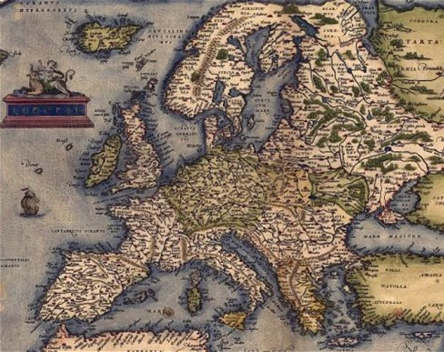
Participants and ROLES
Core Partners
5 UNamur University of Namur, Research Centre in Information, Law and Society, BE
Legal expertise, Task lead 2.1
10 Fraunhofer Institute for Systems and Innovation Research, Karlsruhe, DE
Social science (and ethics) expertise, WP 2 Lead, Task Lead 2.3, 2.4
35 MRU Mykolas Romeris University, Institute of Int. and EU Law, Vilnius, LT
Legal expertise, Task lead 2.2
43 INOV Inesc Inovação - Instituto De Novas Tecnologias, Lisbon, PT
Diversity, auditing expertise, Task lead 2.5, Interface to WP 12
Interface Partners
1 CEA Interface to WP 1 ▶︎ 33 L3C Interface to WP 4 / T-SHARK
12 TUM Interface to WP 3 ▶︎ 23 IMT Interface to WP 5 / CAPE
29 CNR Interface to WP 8 ▶︎ 27 CINI Interface to WP 6 / HAII-T
7 BUT Interface to WP 9 ▶︎ 40 ITTI Interface to WP 7 / SAFAIR
37 SMILE Interface to WP 10
4 CETIC Interface to WP 11
3 TNK Interface to WP 13

Slide 3
Objectives
Make sure that cybersecurity innovations launched by SPARTA are ethically sound, socially acceptable and compliant with applicable (data protection) laws
On line with common (public) problem conception and do not raise concerns among citizens
Proportionate, transparent and ensuring security and confidentiality
Reconciled (balanced) with other values, interests, rights and freedoms
ELSA auditing and supervision
have programs taken into account ELSA that have been raised? Justification for specific solutions.

Slide 4
Tasks
# | Title | Lead | Starts | Ends | Deviations / Measures
T2.1 | Identification of relevant ethical, legal and societal aspects | 5 UNamur | M1 | M12 | Ongoing, no deviations
T2.2 | Investigation of key challenges and promising solution approaches | 35 MRU | M13 | M24 | Not started
T2.3 | Formulation of general guidelines for responsible cybersecurity | 10 Fraunhofer | M7 | M36 | Just started
T2.4 | Conversion of approaches into concrete solutions with the SPARTA Programs | 10 Fraunhofer | M19 | M36 | Not started
T2.5 | Internal ELSA auditing and supervision | 43 INOV | M1 | M36 | Ongoing, no deviations

Slide 5
Deliverables
# | Title | Lead | Due | Sub-mitted | Deviations / Measures
D2.1 | Ethical, legal, and societal aspects | 5 UNamur | M12 = Jan 2020 | – | none
D2.2 | First internal ELSA audit and supervision report | 43 INOV | M12 | – | none
D2.3 | Key challenges and promising solution approaches | 35 MRU | M24 = Jan 2021 | – | none
D2.4 | Second internal ELSA audit and supervision report | 43 INOV | M24 | – | none
D2.5 | Concrete ELSA solutions from the SPARTA programs | 10 Fraunhofer | M36 = Jan 2022 | – | none
D2.6 | General guidelines for responsible cybersecurity research and innovation | 10 Fraunhofer | M36 | – | none
D2.7 | Final internal ELSA audit and supervision report | 43 INOV | M36 | – | none

Slide 6
RISKS
# | Title | Occurrence | Date | Measures deployed
R2.1 | Limited interaction with programs and other activities | n/y | 2019 | All partners have been reminded to provide input for the ongoing work in task 2.1 to attend WP 2 events
RX.2 |  | Y/N | MXX
RX.3 |  | Y/N | MXX
RX.4 |  | Y/N | MXX

Slide 7
KPI
# | Description | M12 target | M06 status | Deviations / Measures
3.3 | Share of women in groups and workshops | +10% | – | First workshop later today
7.4 | # of responsible research and innovation debates and # of participants | 1 debate +22 part. | – | First workshop later today

Slide 8
Miscellaneous

