Slide 1
Task 2.5
Internal ethical, legal and societal aspects (ELSA) auditing and supervision
(M01-M36; Task Lead: INOV)
Gonçalo Cadete (INOV)
Second ELSA Audit
New ELSA Champions 2020
October 20th, 2020

Slide 2
Second ELSA Audit PResentation
1 | What is ELSA all about ?
2 | Goals of the ELSA Audit ?
3 | How to rate ?
4 | How to ask for support ?

Slide 3
Second Internal ELSA audit 1. What is ELSA all about ?
Ensure high standards in the SPARTA Project:
Ethical conformance: enabling culture, ethics, and behavior
Legal compliance: focus on data protection, privacy, GDPR
Societal acceptance
Why should we care?
We are Europeans! ☺
Responsible research and innovation

Slide 4
Second Internal ELSA audit 2. Goals of the ELSA audit ?
We SPARTANS want to achieve:
Improve our ELSA awareness
Build our ELSA capabilities
Contribute to state-of-the-art Governance
Be recognized as Responsible Researchers
Be recognized as Responsible Innovators
Create a great working environment!
Create a meaningful working environment!
Attract and retain diverse talent!

Slide 5
Second Internal ELSA audit 3. How to Rate ? 25 statements + Is the Audit useful?
Same as last year, see deliverable D2.2:
25 statements / questions; ELSA assurance perspective.
1 usefulness rating: “Is the ELSA Audit useful for promoting RRI?”
How to answer? Simply rate your agreement level:
FA: Fully Agree/Achieved [85% - 100%]
LA: Largely Agree/Achieved [50% - 85%[
PA: Partially Agree/Achieved [15% - 50%[
NA: Not Agree/Achieved [ 0% - 15%[
Very positive.
Positive.
Negative.
Very negative.

Slide 6
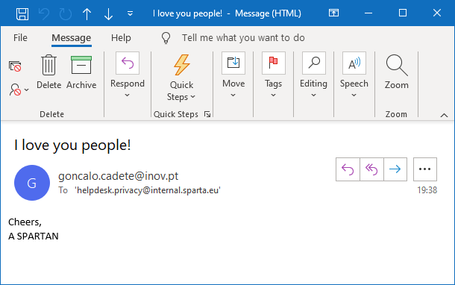
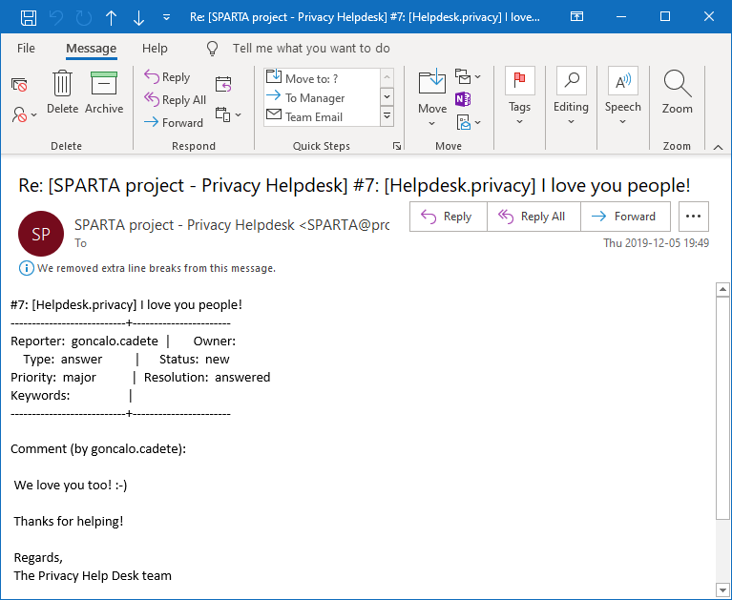
SEcond Internal ELSA audit 4. How to ask for support ?
Please use the SPARTA Privacy Help Desk :
Email To: helpdesk.privacy@internal.sparta.eu
Your question or feedback…
…won’t be ignored ! ☺
ticket #7

Slide 7
Thank you for Participating!

